Slide 1

Data Structure & Algorithms
Submitted By:-
Seema Sharma
Assistant Prof - CSE

Slide 2
Unit 3 Queues & Linked List

Slide 3
What is a queue?
It is an ordered group of homogeneous items of elements.
Queues have two ends:
Elements are added at one end.
Elements are removed from the other end.
The element added first is also removed first (FIFO: First In, First Out).

Slide 4
Queue Specification
Definitions: (provided by the user)
MAX_ITEMS: Max number of items that might be on the queue
ItemType: Data type of the items on the queue

Slide 5
Enqueue (ItemType newItem)
Function: Adds newItem to the rear of the queue.
Preconditions: Queue has been initialized and is not full.
Postconditions: newItem is at rear of queue.

Slide 6
Dequeue (ItemType& item)
Function: Removes front item from queue and returns it in item.
Preconditions: Queue has been initialized and is not empty.
Postconditions: Front element has been removed from queue and item is a copy of removed element.

Slide 7
Implementation issues
Implement the queue as a circular structure.
How do we know if a queue is full or empty?
Initialization of front and rear.
Testing for a full or empty queue.

Slide 8
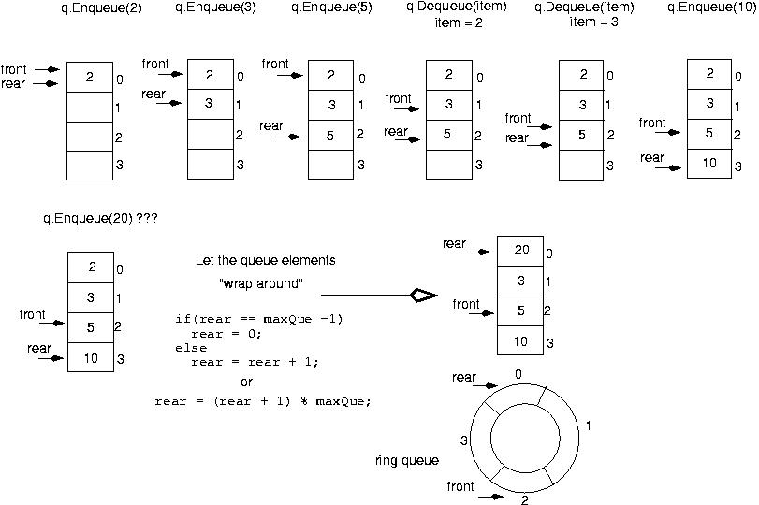

Slide 9
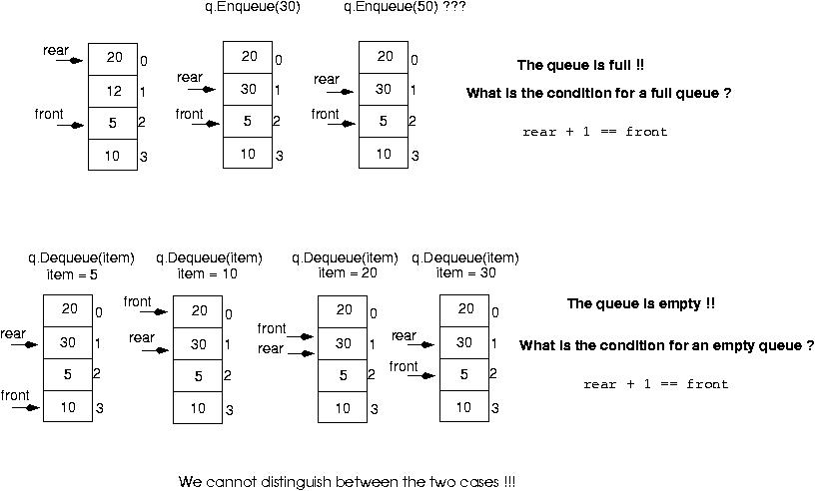

Slide 10
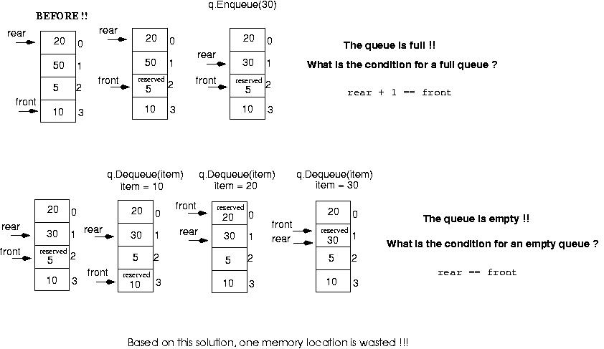
Make front point to the element preceding the front element in the queue (one memory location will be wasted).

Slide 11
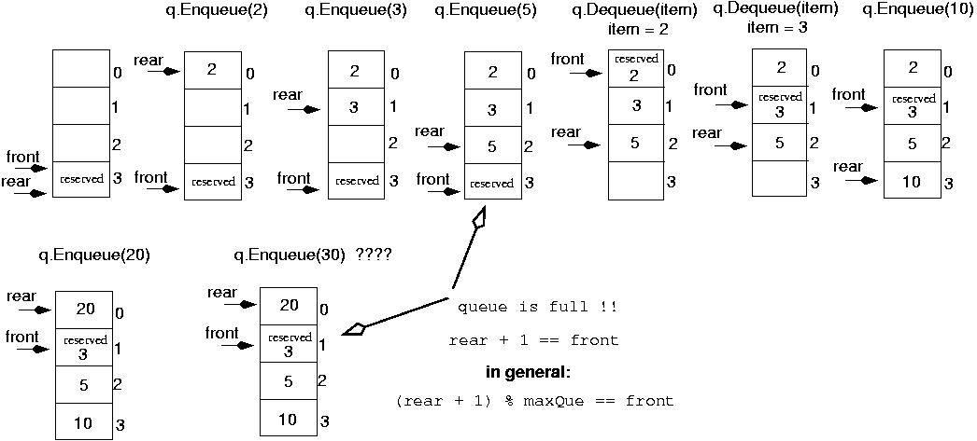
Initialize front and rear

Slide 12
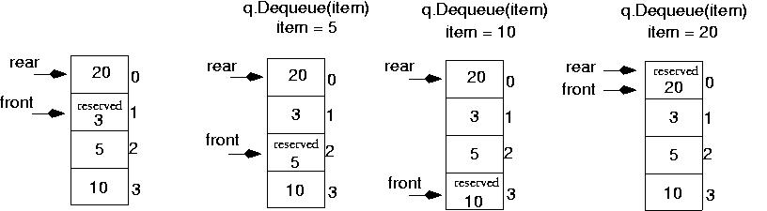
Queue is empty now!!
rear == front

Slide 13
Queue overflow
The condition resulting from trying to add an element onto a full queue.
if(!q.IsFull())
q.Enqueue(item);

Slide 14
Queue underflow
The condition resulting from trying to remove an element from an empty queue.
if(!q.IsEmpty())
q.Dequeue(item);

Slide 15
Linked Lists

Slide 16
Introduction
Definitions
Lists and arrays
Nodes and pointers
Single Linked Lists
Double Linked Lists
Circular Lists
Advantages

Slide 17
Introduction
Definitions
Lists and arrays
Nodes and pointers
Single Linked Lists
Double Linked Lists
Circular Lists
Advantages

Slide 18

Lists and arrays
Lists:

Slide 19
Lists and arrays
Arrays:
{Size of the following array is = 4}
Index | 0 | 1 | 2 | 3
Value | 44 | 5 | 96 | 3

Slide 20
Introduction
Definitions
Lists and arrays
Nodes and pointers
Single Linked Lists
Double Linked Lists
Circular Lists
Advantages

Slide 21

Nodes and pointers

Slide 22
Introduction
Definitions
Lists and arrays
Nodes and pointers
Single Linked Lists
Double Linked Lists
Circular Lists
Advantages

Slide 23
Single linked lists

Slide 24
Introduction
Definitions
Lists and arrays
Nodes and pointers
Single Linked Lists
Double Linked Lists
Circular Lists
Advantages

Slide 25

Double Linked Lists

Slide 26
Introduction
Definitions
Lists and arrays
Nodes and pointers
Single Linked Lists
Double Linked Lists
Circular Lists
Advantages

Slide 27
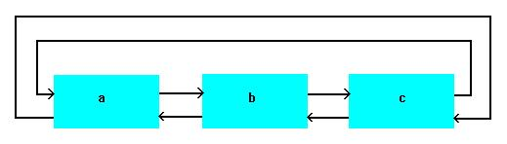
Circular Lists

Slide 28
Introduction
Definitions
Lists and arrays
Nodes and pointers
Single Linked Lists
Double Linked Lists
Circular Lists
Advantages

Slide 29
Advantages
The Linked List advantages are collected because of the array disadvantages, array disadvantages are:
Array Size
Memory allocation
Insertion and Deletion

Slide 30
Insertion Description
Insertion at the top of the list
Insertion at the end of the list
Insertion in the middle of the list

Slide 31
Insertion Description
Insertion at the top of the list
Insertion at the end of the list
Insertion in the middle of the list

Slide 32
Insertion at the top
Steps:
Create a Node
Set the node data Values
Connect the pointers

Slide 33


Insertion Description
head
48
17
142
//
Follow the previous steps and we get
Step 1
Step 2
Step 3
head
93

Slide 34
Insertion Description
Insertion at the top of the list
Insertion at the end of the list
Insertion in the middle of the list

Slide 35
Insertion at the end
Steps:
Create a Node
Set the node data Values
Connect the pointers

Slide 36



Insertion Description
head
48
17
142
//
Follow the previous steps and we get
Step 1
Step 2
Step 3

Slide 37
Insertion Description
Insertion at the top of the list
Insertion at the end of the list
Insertion in the middle of the list

Slide 38
Insertion in the middle
Steps:
Create a Node
Set the node data Values
Break pointer connection
Re-connect the pointers

Slide 39




Insertion Description
Step 1
Step 2
Step 3
Step 4

Slide 40
Deletion Description
Deleting from the top of the list
Deleting from the end of the list
Deleting from the middle of the list

Slide 41
Deletion Description
Deleting from the top of the list
Deleting from the end of the list
Deleting from the middle of the list

Slide 42
Deleting from the top
Steps
Break the pointer connection
Re-connect the nodes
Delete the node

Slide 43
Deletion Description
head
6
4
17
42
head
6
4
17
42
head
4
17
42

Slide 44
Deletion Description
Deleting from the top of the list
Deleting from the end of the list
Deleting from the middle of the list

Slide 45
Deleting from the end
Steps
Break the pointer connection
Set previous node pointer to NULL
Delete the node

Slide 46
Deletion Description
head
6
4
17
42
head
6
4
17
42
head
6
4
17

Slide 47
Deletion Description
Deleting from the top of the list
Deleting from the end of the list
Deleting from the middle of the list

Slide 48
Deleting from the Middle
Steps
Set previous Node pointer to next node
Break Node pointer connection
Delete the node

Slide 49
Deletion Description
head
4
17
42
head
4
17
42
head
4
42

Slide 50
Basic Node Implementation
The following code is written in C++:
Struct Node
{
int data; //any type of data could be another struct
Node *next; //this is an important piece of code “pointer”
};

